Slide 1
CONTENTS
Introduction
Substitute for cement
Work done till date
Materials used for mix
Procedure for casting
Different mix proportions
Results of cubes
Advantages of GPC
Future works
Topic discussion
Design of panel
Fixing of panel
Tests to be conducted on panel
Conclusion

Slide 2
INTRODUCTION
For any type of construction the first thing needed is cement .
It is the highly demanded material for all type of constructions , it is easily available .
And it is the most consumed commodity in the world after water .
It is also the most energy intensive material .
Cement production leads to high carbon-dioxide emission .
1 ton of CO2 is produced for every 1 ton of cement .
It is produced by calcination of limestone and burning of fossil fuels.
By continuing usage of cement we are even depleting our natural resources , causing harm to our environment .

Slide 3
SUBSTITUTE FOR CEMENT
Cement can be substuted with other materials .
Many attempts were made and one of the successful attempts is substuting it with Geo Polymer Concrete .
GPC is an innovative , eco-friendly construction material .
In GPC cement is not used as binding material .
Fly ash , silica-fume , or GGBS , along with alkali solution are used as binders .
It is used as replacement of cement concrete .

Slide 4
WORK DONE TILL DATE

Slide 5
MATERIALS USED FOR MIX
Coarse Aggregate
Fine Aggregate
Binders = Flyash , G.G.B.S.
Alkali Solution = NaOH/KOH , Na2SiO3
Super Plastizer = Conplast SP 430
Robo Sand / Stone Dust

Slide 6
PROCEDURE FOR CASTING
Preperation of alkali solution by mixing NaOH/KOH with sodium silicate solution 1 day before casting .
F.A , C.A , fly ash , G.G.B.S , robo sand are dry mixed for 3 mins .
Then alkali solutionis added to the dry mix and mixed for 4 mins .
Lastly extra water with S.P will be added to get workable Geopolymer concrete .
Cubes are casted
The cubes are demoulded after 24 hrs .

Slide 7
Continued…
The cubes are then kept in oven for another 24 hrs at 50 degrees temperature .
The cubes are then removed at kept at normal room temperature .
After the days are passed tests can be continued normally..

Slide 8
DIFFERENT MIX PROPORTIONS
NaOH 1 = C.A + F.A + Binders + Alkali Solution ( NaOH + Na2SiO3 ) + S.P
NaOH 2 = C.A + F.A (50% of total weight of robo sand) + Binders + Alkali Solution (NaOH + Na2SiO3 ) + S.P
KOH 1 = C.A + F.A (50% of total weight of robo sand) + Binders + Alkali Solution (KOH + Na2SiO3) + S.P
KOH 2 = C.A + F.A + Binders + Alkali Solution (KOH +Na2SiO3) + S.P

Slide 9
RESULT OF CUBES
CUBE TYPE | 7 DAYS | 14 DAYS
OPC 1 | =491.5 KN =21.84 MPa | =871.2 KN =38.72 MPa
NaOH 1 | =759.3 KN =33.74 MPa | =906.9 KN =40.30 MPa
NaOH 2 | =1219.1 KN =54.118 MPa
KOH 3 | =1340.3 KN =59.56 MPa
KOH 4 | =1097.9 KN =48.79 MPa

Slide 10
ADVANTAGES OF GPC
Reduces the demand pf OPC which leads CO2 emission .
Utilize waste materials from industries such as fly ash , silica-fume , GGBS .
Protect water bodies from contamination due to fly ash disposal .
Conserve acres of land that would have been used for coal combustion products disposal .
Produce a more durable infrastructure .
It is economical .
Works same as OPC .

Slide 11
FUTURE WORKS

Slide 12
TOPIC DISCUSSION
Panel size = 1 feet by 1 feet by 6 inches
= 0.305 metres by 0.305metres by 0.152 metre
= 30.5 cm by 30.5 cm by 15.24 cm
Two different sandwhich panels with thermocol and plastic granuels as filling inbetween .
The panels will be tested after 7 days and 14 days .

Slide 13
DESIGN OF PANEL
The panels of GPC will be casted seperately .
Thermocol of the same dimensions will be taken .
Plastic granuels will be prepared with the help of cement as binder .
Epoxy resign will be used to join the panels together .
Reinforcement will be done using 8mm dia bars .

Slide 14
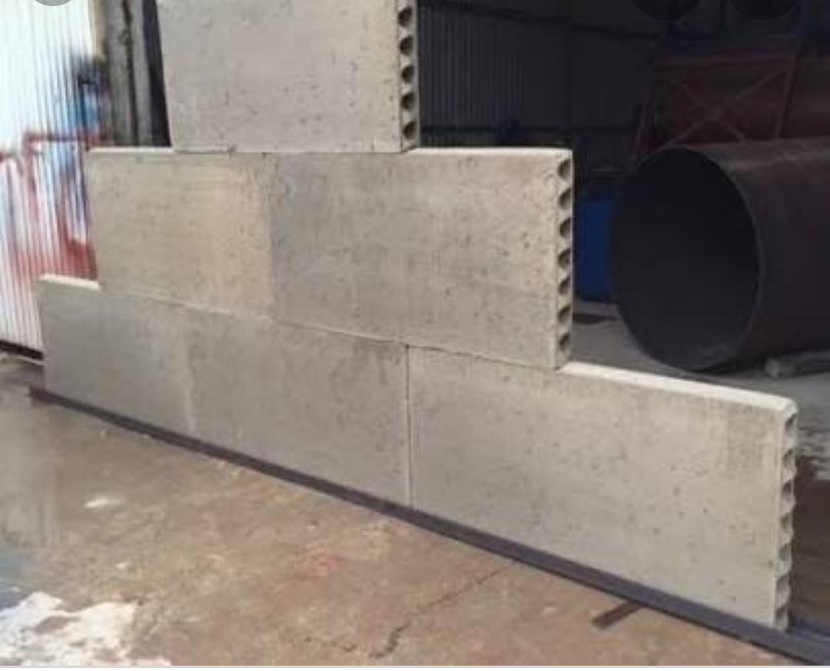
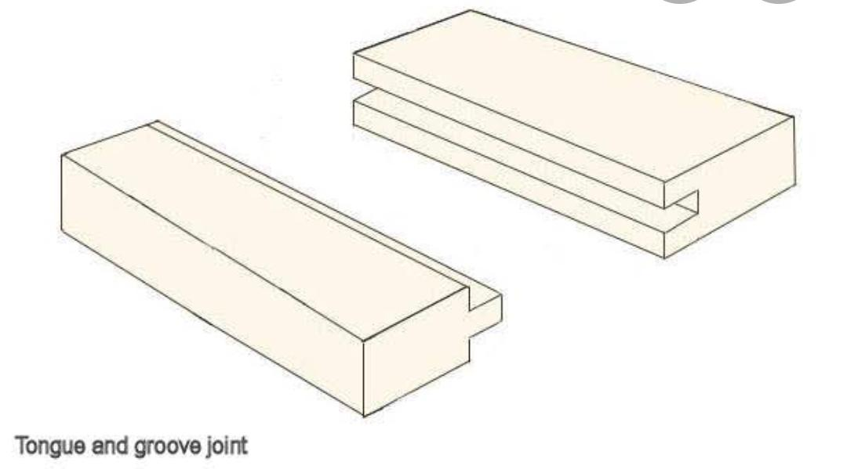
FIXING OF PANELS
Tongue and groove method (male and female projection)
Post tensioning method

Slide 15
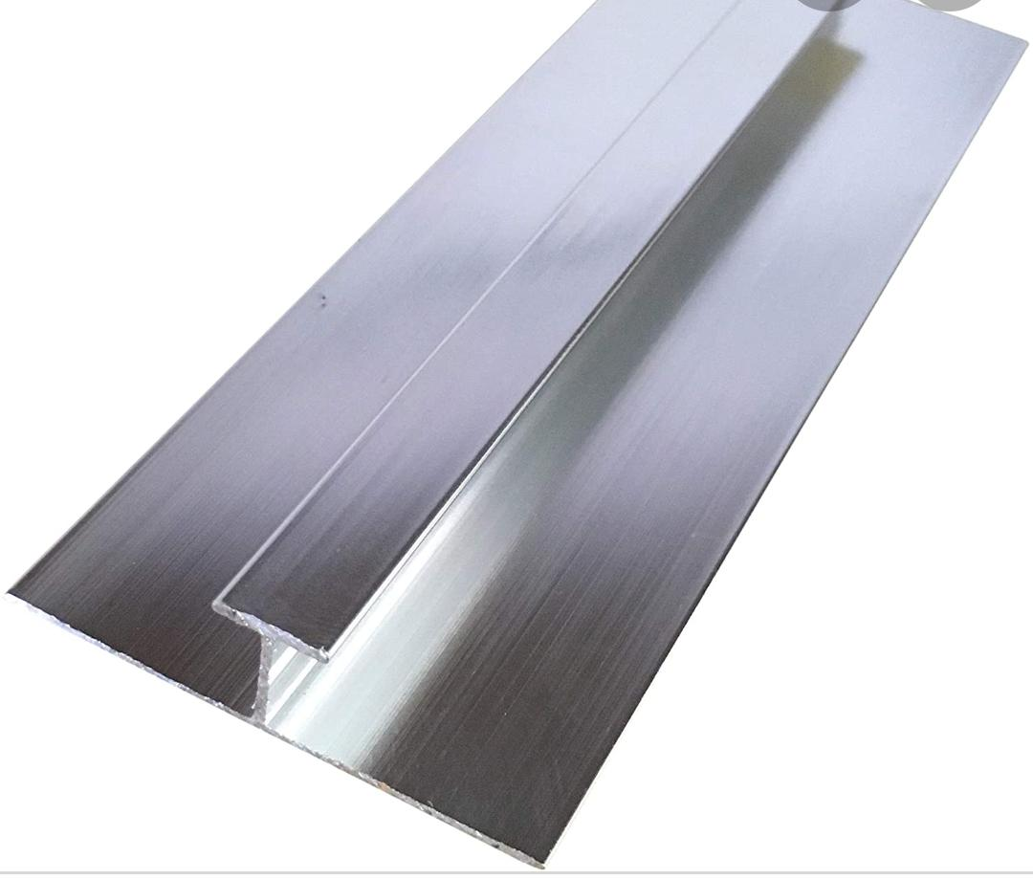
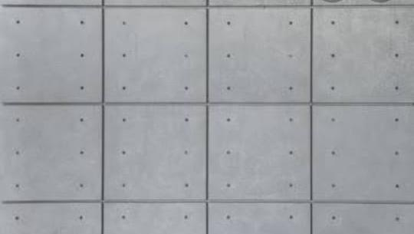
Conti…
Steel frames where panels can slide and stick to one another by cementing material .
Nut and bolt fixing

Slide 16
TESTS TO BE CONDUCTED ON PANEL
Compressive Strength
Flexural Strength
Impact Test
Fire Test
Water Test

Slide 17
CONCLUSION
Project is still going on , this is the review of the work done till now .

Slide 18
THANK YOU

